Slide 1
INFO-3142
Introduction to PyTorch

Slide 2
Introduction to PyTorch
PyTorch (https://pytorch.org/) is an open-source Python-based deep learning library
PyTorch has been the most widely used deep learning library for research since 2019 by a wide margin
Often contrasted and compared with Google’s TensorFlow library
One of the reasons PyTorch is so popular is its user-friendly interface and efficiency
Despite its accessibility, it doesn’t compromise on flexibility, allowing advanced users to tweak lower-level aspects of their models for customization and optimization
In short, for many practitioners and researchers, PyTorch offers just the right balance between usability and features

Slide 3
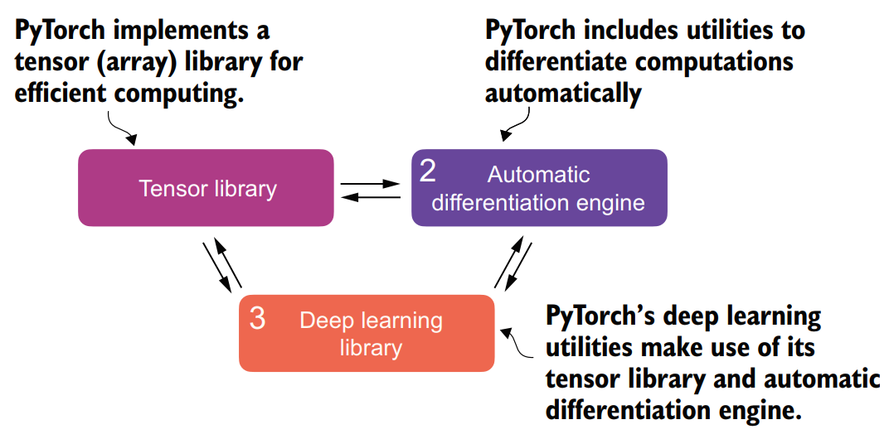
Core Components of PyTorch
PyTorch’s three main components include:
tensor library as a fundamental building block for doing computing
automatic differentiation for model optimization
deep learning utility functions, making it easier to implement and train deep neural network models

Slide 4
1. What is Deep Learning?
To begin with, what’s the difference between Artificial Intelligence, Machine Learning and Deep Learning?
AI is fundamentally about creating computer systems capable of performing tasks that usually require human intelligence:
Understanding natural language
Recognizing patterns
Making decisions
Machine learning represents a subfield of AI that focuses on developing and improving learning algorithms
The key idea behind machine learning is to enable computers to learn from data and make predictions or decisions without being explicitly programmed to perform the task

Slide 5
2. What is Deep Learning?
Deep learning is a subcategory of machine learning that focuses on the training and application of deep neural networks
These deep neural networks were originally inspired by how the human brain works, particularly the interconnection between many neurons
The “deep” in deep learning refers to the multiple hidden layers of artificial neurons or nodes that allow them to model complex, nonlinear relationships in the data

Slide 6
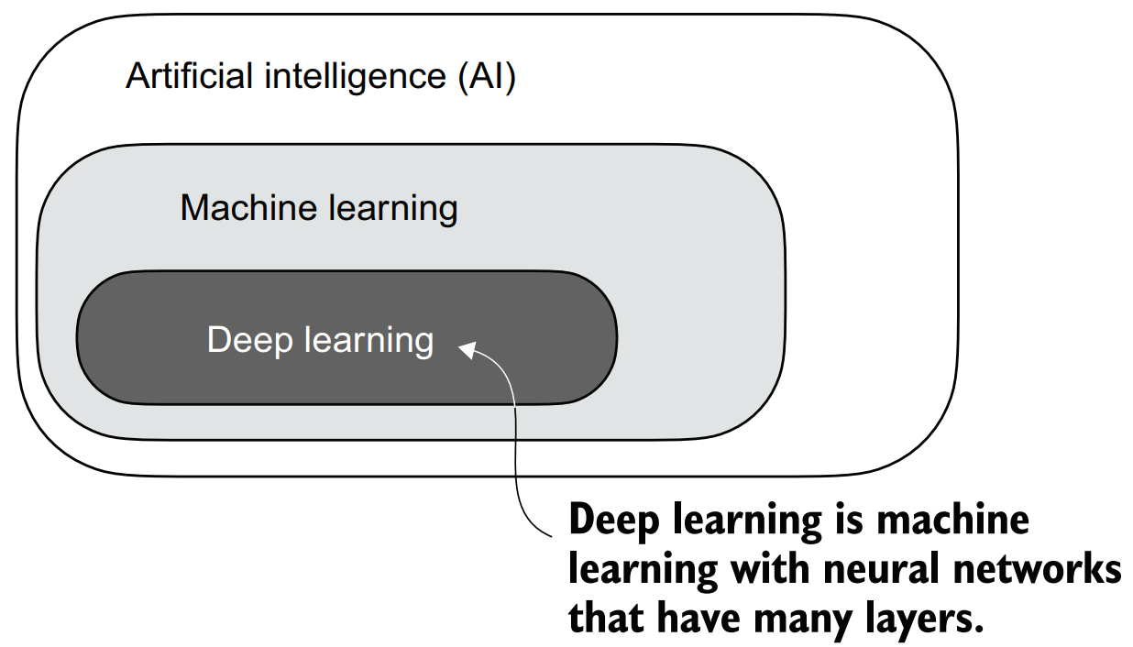
3. What is Deep Learning?
Unlike traditional machine learning techniques that excel at simple pattern recognition, deep learning is particularly good at handling unstructured data like images, audio, or text, so it is particularly well suited for LLMs and Generative AI

Slide 7
1. Supervised Learning
The typical predictive modeling workflow in machine learning and deep learning is called supervised learning
Using a learning algorithm, a model is trained on a training dataset consisting of examples and corresponding labels
In the case of an email spam classifier, for example, the training dataset consists of emails and their “spam” and “not spam” labels that a human identified
The trained model can then be used on new observations (i.e., new emails) to predict their unknown label (“spam” or “not spam”)
It’s also important to add a model evaluation between the training and inference stages to ensure that the model satisfies our performance criteria before using it in a real-world application

Slide 8
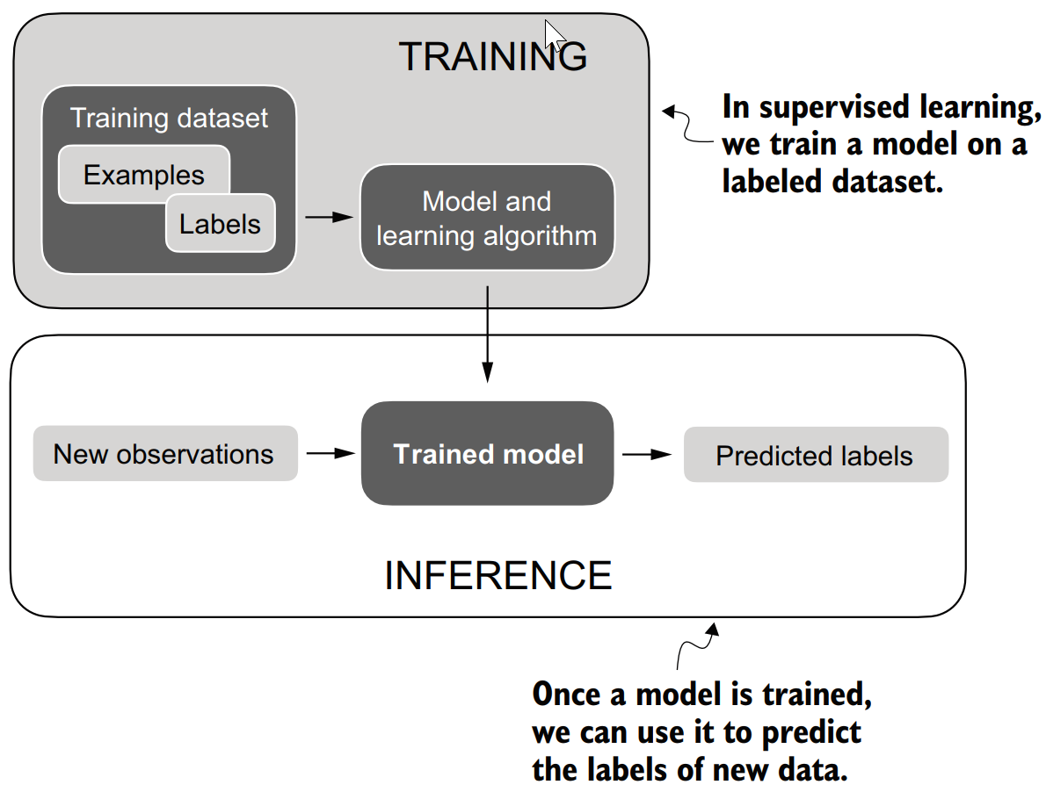
2. Supervised Learning

Slide 9
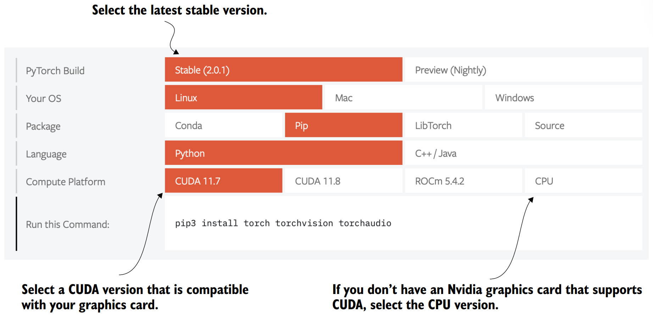
Installing PyTorch
https://pytorch.org

Slide 10
1. Understanding Tensors
Tensors represent a mathematical concept that generalizes vectors and matrices to potentially higher dimensions
Tensors are mathematical objects that can be characterized by their order (or rank), which provides the number of dimensions
Example:
a scalar (just a number) is a tensor of rank 0
a vector is a tensor of rank 1
a matrix is a tensor of rank 2

Slide 11
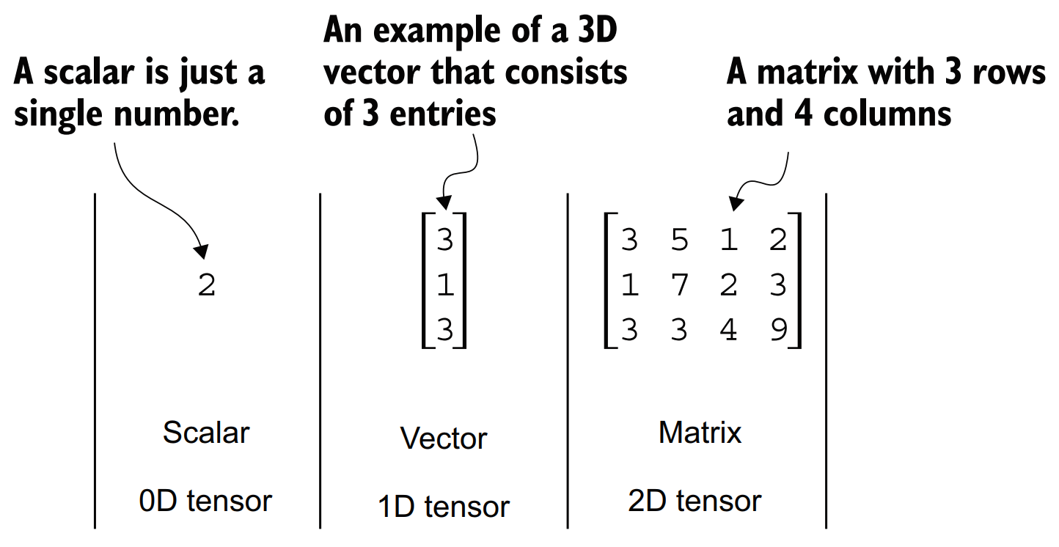
2. Understanding Tensors

Slide 12
3. Understanding Tensors
From a computational perspective, tensors serve as data containers
For instance, they hold multidimensional data, where each dimension represents a different feature
Tensor libraries like PyTorch can create, manipulate, and compute with these arrays efficiently
In this context, a tensor library functions as an array library
PyTorch tensors are similar to NumPy arrays but have several additional features that are important for deep learning
Example:
PyTorch adds an automatic differentiation engine, simplifying computing gradients
PyTorch tensors also support GPU computations to speed up deep neural network training

Slide 13
Scalars, Vectors, Matrices and Tensors
PyTorch tensors are data containers for array-like structures
A scalar is a zero-dimensional tensor (for instance, just a number)
A vector is a one-dimensional tensor, and
A matrix is a two-dimensional tensor
There is no specific term for higher-dimensional tensors, so we typically refer to a three-dimensional tensor as just a 3D tensor, and so forth

Slide 14
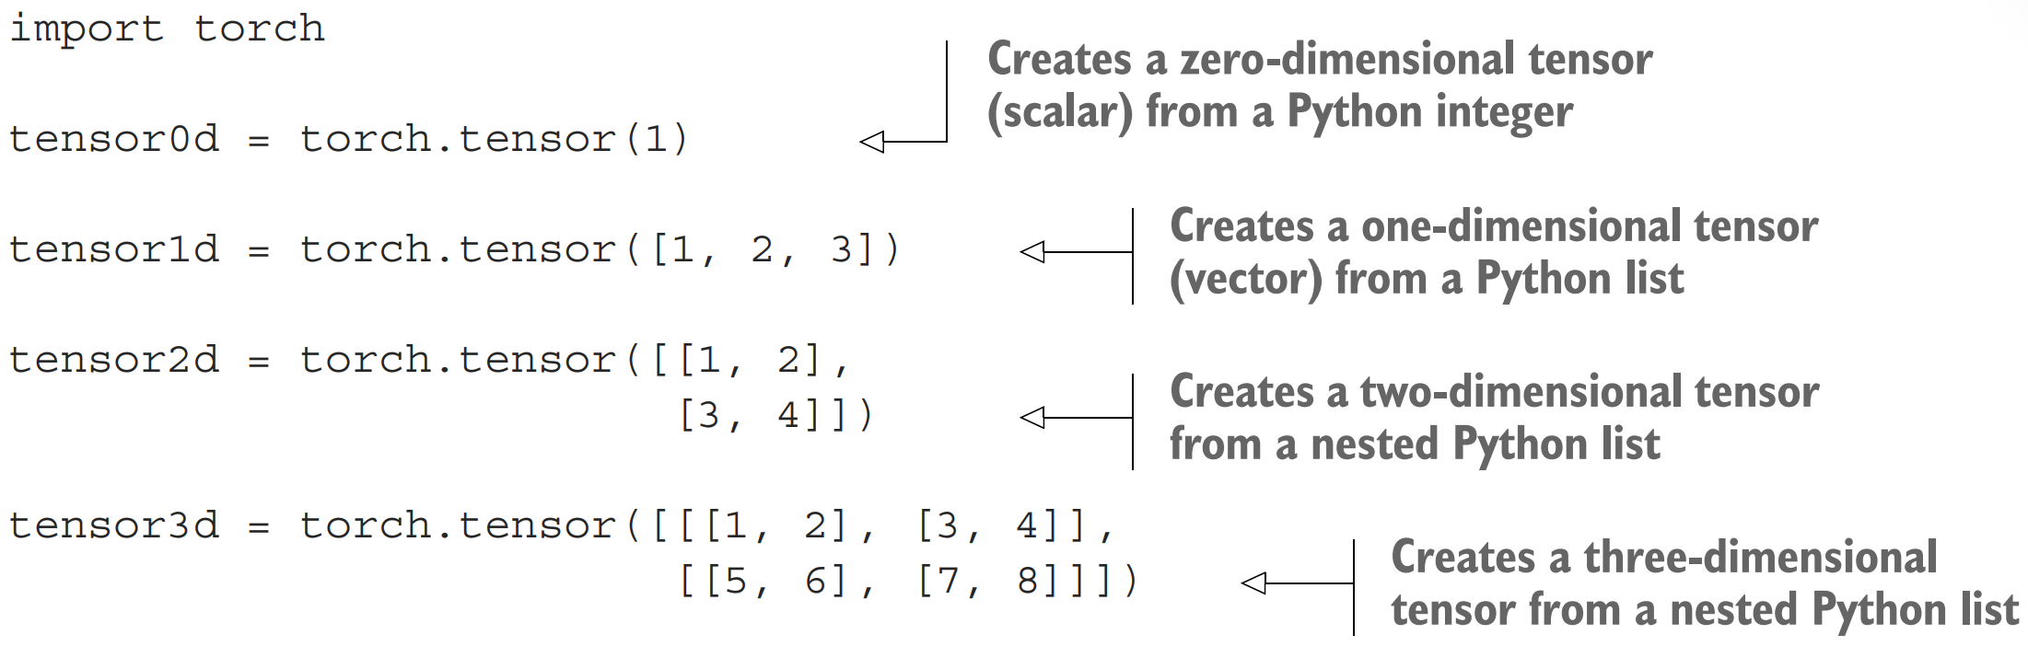
Creating PyTorch Tensors

Slide 15
1. Tensor Data Types
tensor1d = torch.tensor([1, 2, 3]) print(tensor1d.dtype)
This prints
torch.int64
If we create tensors from Python floats, PyTorch creates tensors with a 32-bit precision by default:
floatvec = torch.tensor([1.0, 2.0, 3.0]) print(floatvec.dtype)
The output is
torch.float32

Slide 16
2. Tensor Data Types
A 32-bit floating-point number offers sufficient precision for most deep learning tasks while consuming less memory and computational resources than a 64-bit floatingpoint number
Moreover, GPU architectures are optimized for 32-bit computations, and using this data type can significantly speed up model training and inference
Also, it’s possible to change the precision using a tensor’s .to method
Changing a 64-bit integer tensor into a 32-bit float tensor:
floatvec = tensor1d.to(torch.float32)
print(floatvec.dtype)
torch.float32

Slide 17
1. Common PyTorch Tensor Operations
tensor2d = torch.tensor([[1, 2, 3], [4, 5, 6]]) print(tensor2d)
tensor([[1, 2, 3], [4, 5, 6]])
In addition, the .shape attribute allows us to access the shape of a tensor:
print(tensor2d.shape)
torch.Size([2, 3])
.shape returns [2, 3], meaning the tensor has two rows and three columns

Slide 18
2. Common PyTorch Tensor Operations
To reshape the tensor into a 3 × 2 tensor, we can use the .reshape method:
print(tensor2d.reshape(3, 2))
tensor([[1, 2], [3, 4], [5, 6]])
The more common command for reshaping tensors in PyTorch is .view():
print(tensor2d.view(3, 2))
tensor([[1, 2], [3, 4], [5, 6]])

Slide 19
3. Common PyTorch Tensor Operations
The subtle difference between .view() and .reshape() in PyTorch lies in their handling of memory layout:
.view() requires the original data to be contiguous and will fail if it isn’t
.reshape() will work regardless, copying the data if necessary to ensure the desired shape

Slide 20
4. Common PyTorch Tensor Operations
Next, we can use .T to transpose a tensor, which means flipping it across its diagonal
Note that this is not the same as reshaping a tensor, as you can see based on the following result:
print(tensor2d.T)
tensor([[1, 4], [2, 5], [3, 6]])

Slide 21
5. Common PyTorch Tensor Operations
Finally, the common way to multiply two matrices in PyTorch is the .matmul method:
print(tensor2d.matmul(tensor2d.T))
tensor([[14, 32], [32, 77]])
We can also adopt the @ operator, which accomplishes the same thing more compactly:
print(tensor2d @ tensor2d.T)
tensor([[14, 32], [32, 77]])

Slide 22
1. Seeing Models as Computation Graphs
PyTorch has an automatic differentiation engine called autograd
PyTorch’s autograd system provides functions to compute gradients in dynamic computational graphs automatically
A computational graph is a directed graph that allows us to express and visualize mathematical expressions
In the context of deep learning, a computation graph lays out the sequence of calculations needed to compute the output of a neural network
we will need this to compute the required gradients for backpropagation, the main training algorithm for neural networks

Slide 23
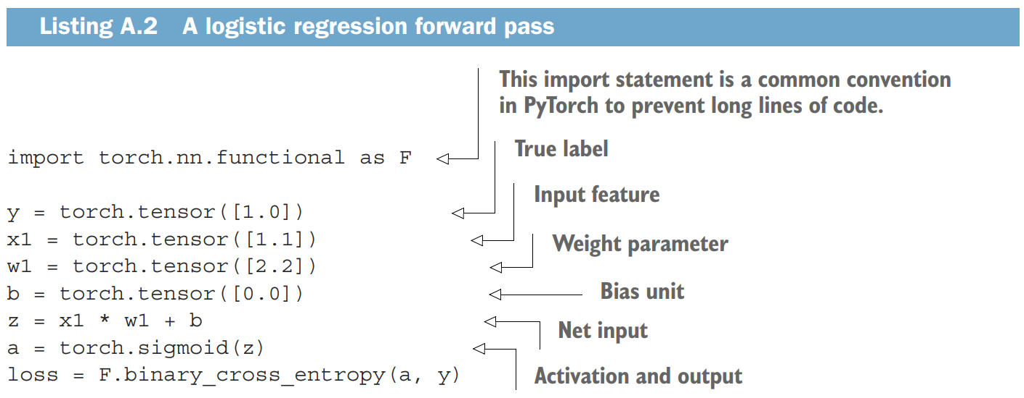
2. Seeing Models as Computation Graphs
Consider a simple logistic regression classifier
can be seen as a single-layer neural network
It returns a score between 0 and 1, which is compared to the true class label (0 or 1) when computing the loss

Slide 24
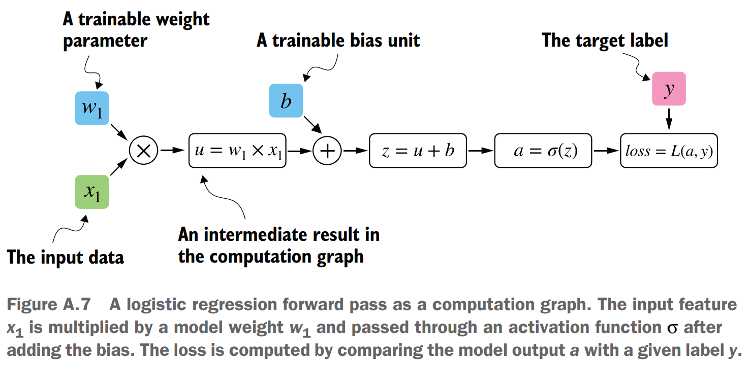
3. Seeing Models as Computation Graphs
In fact, PyTorch builds such a computation graph in the background, and we can use this to calculate gradients of a loss function with respect to the model parameters:
(in this case w1 and b) to train the model

Slide 25
1. Automatic Differentiation Made Easy
If we carry out computations in PyTorch…
It will build a computational graph internally by default if one of its terminal nodes has the requires_grad attribute set to True
This is useful if we want to compute gradients
Gradients are required when training neural networks via the popular backpropagation algorithm, which can be considered an implementation of the chain rule from calculus for neural networks

Slide 26
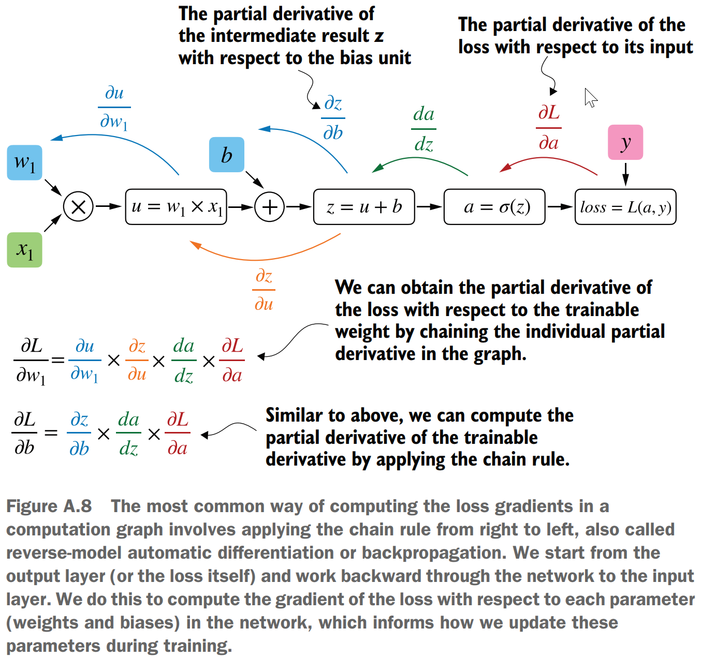
2. Automatic Differentiation Made Easy

Slide 27
1. Partial Derivatives and Gradients
Derivatives measure the rate at which a function changes with respect to one of its variables
A gradient is a vector containing all the partial derivatives of a multivariate function, a function with more than one variable as input
If you are not familiar with or don’t remember the partial derivatives, gradients, or chain rule from calculus, don’t worry
On a high level, all you need to know for this book is that the chain rule is a way to compute gradients of a loss function given the model’s parameters in a computation graph
This provides the information needed to update each parameter to minimize the loss function, which serves as a proxy for measuring the model’s performance using a method such as gradient descent

Slide 28
2. Partial Derivatives and Gradients
How is this all related to the automatic differentiation (autograd) engine?
PyTorch’s autograd engine constructs a computational graph in the background by tracking every operation performed on tensors
Then, calling the grad function, we can compute the gradient of the loss concerning the model parameter w1

Slide 29
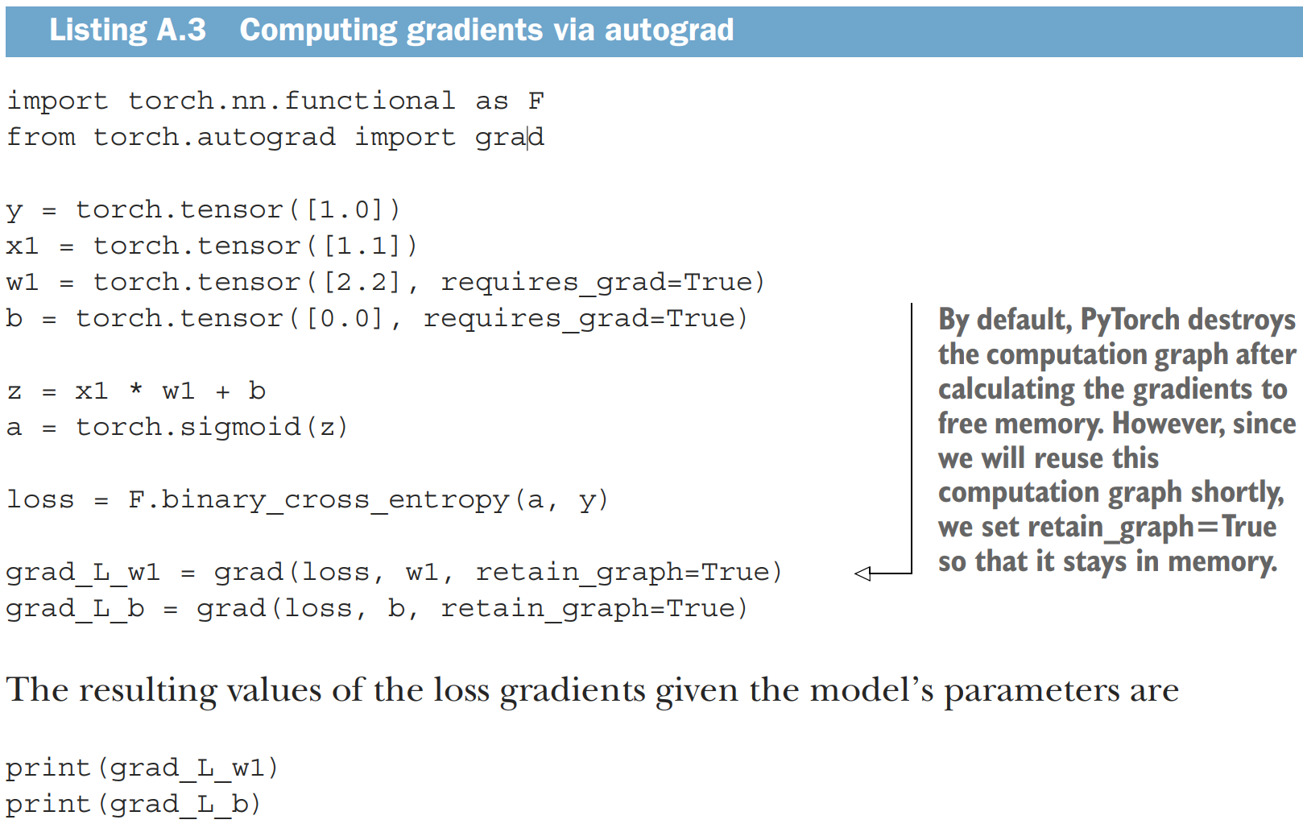
3. Partial Derivatives and Gradients

Slide 30
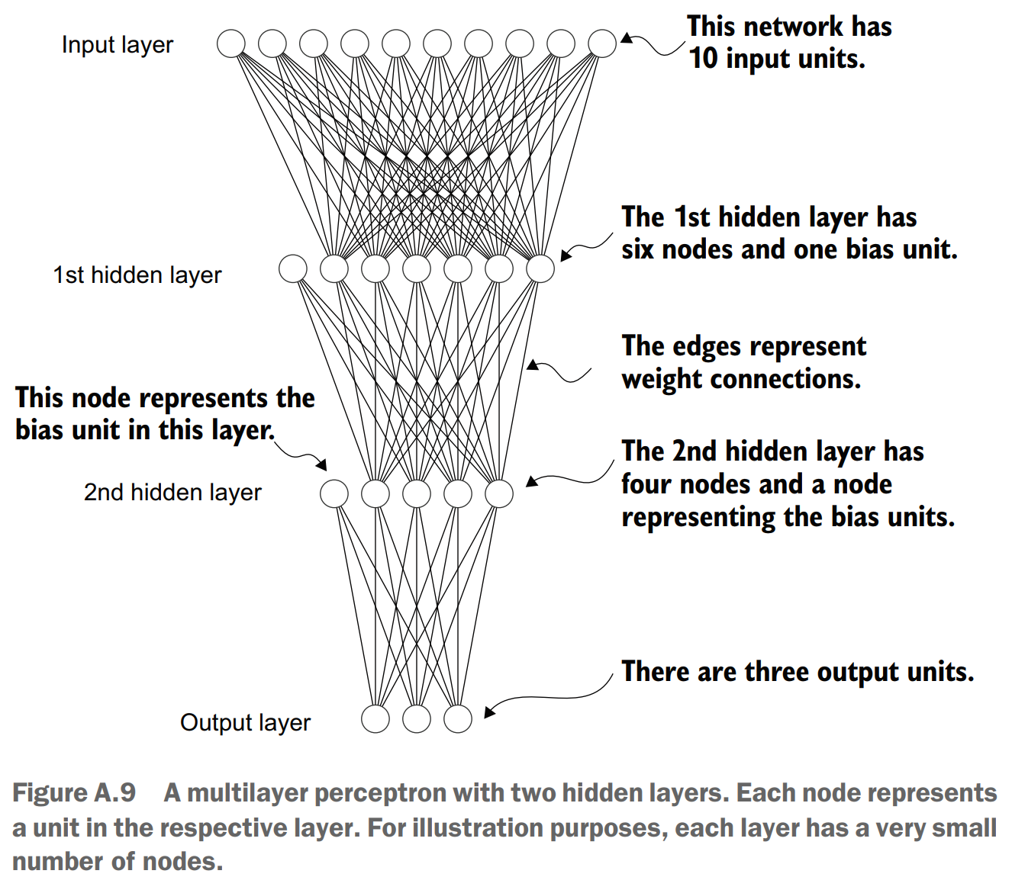
1. Implementing Multilayer Neural Networks
Next, we focus on PyTorch as a library for implementing deep neural networks
Here’s a multilayer perceptron, a fully connected neural network:

Slide 31
2. Implementing Multilayer Neural Networks
When implementing a neural network in PyTorch, we can subclass the torch.nn.Module class to define our own custom network architecture
This Module base class provides a lot of functionality, making it easier to build and train models
For instance, it allows us to encapsulate layers and operations and keep track of the model’s parameters
Within this subclass, we define the network layers in the __init__ constructor and specify how the layers interact in the forward method
The forward method describes how the input data passes through the network and comes together as a computation graph
In contrast, the backward method, which we typically do not need to implement ourselves, is used during training to compute gradients of the loss function given the model parameters

Slide 32
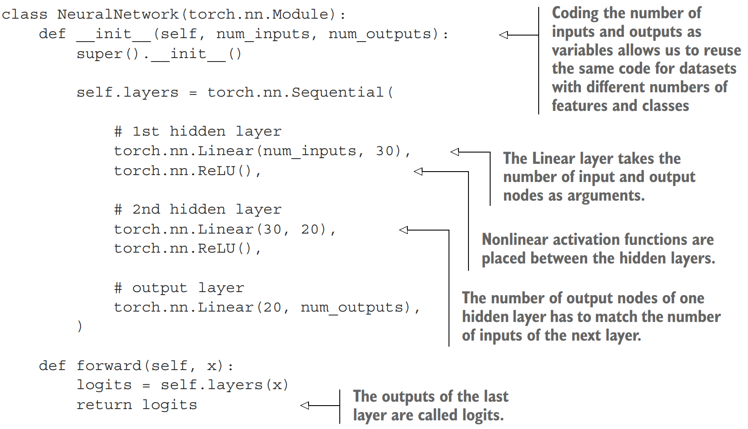
1. A Multilayer Perceptron with Two Hidden Layers

Slide 33
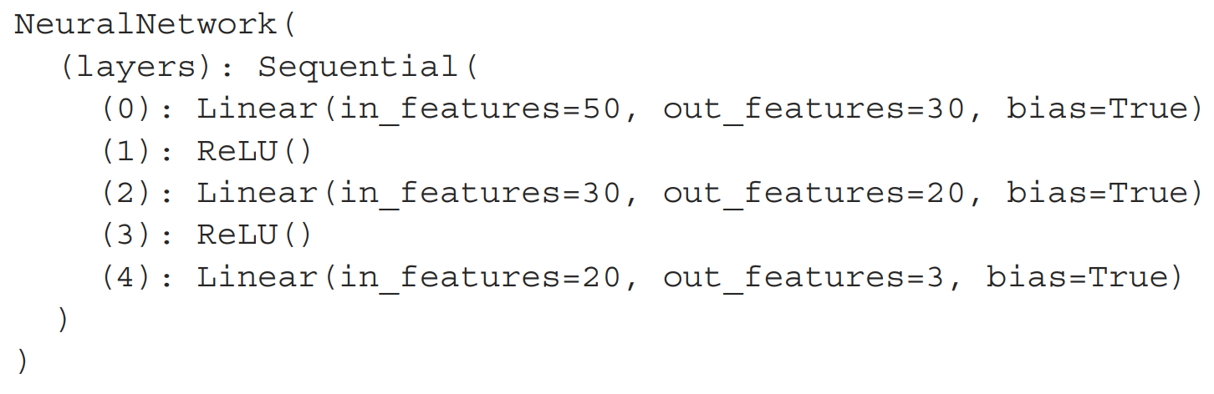
2. A Multilayer Perceptron with Two Hidden Layers
model = NeuralNetwork(50, 3)
print(model)

Slide 34
3. A Multilayer Perceptron with Two Hidden Layers
Note that we use the Sequential class when we implement the NeuralNetwork class. Sequential is not required, but it can make our life easier if we have a series of layers we want to execute in a specific order, as is the case here
This way, after instantiating self.layers = Sequential(...) in the __init__ constructor, we just have to call the self.layers instead of calling each layer individually in the NeuralNetwork’s forward method
Here are the total number of trainable parameters of this model: num_params = sum(p.numel() for p in model.parameters() if p.requires_grad)
print("Total number of trainable model parameters:", num_params)
Total number of trainable model parameters: 2213

